Slide 1


Slide 2
Technology in Action
Midterm Review
Chapters 1-7
Becoming Computer Literate
Crossing the Digital Divide
Notes:
Chapter 1 introduces the basics of becoming computer literate, including many concepts that will be developed throughout the course.

Slide 3
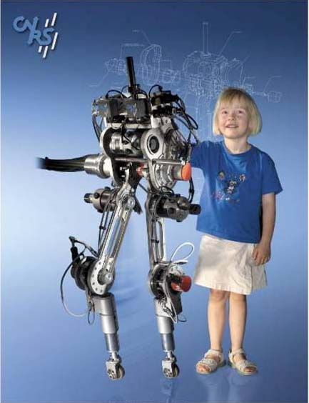
Affective Computing
Computing that relates to emotion or tries to influence emotion
Emotional-Social Prosthesis (ESP) device
Notes:
Affective computing is computing that relates to emotion or deliberately tries to influence emotion.
The Emotional-Social Prosthesis device (ESP), developed by a group at the MIT Media Lab, is targeted at helping people who have autism.
Researchers are also working on bipedal robots that move like humans and can walk, run, and climb stairs.

Slide 4
Chapter 1 Summary Questions
What does it mean to be “computer literate”?
Notes:
What does it mean to be “computer literate”?

Slide 5
Chapter 1 Summary Questions
How does being computer literate make you a savvy computer user and consumer?
Notes:
How does being computer literate make you a savvy computer user and consumer?

Slide 6
Technology in Action
Chapter 2
Looking at Computers: Understanding the Parts
Notes:
2
Chapter 2 takes a look at the different parts of a computer.

Slide 7
Computers Are Data
Processing Devices
A computer’s four major functions:
  Gathers data (users input data)
  Processes data into information
  Outputs data or information
  Stores data and information
Notes:
4
Strictly defined, a computer is a data processing device that performs four major functions:
1. It gathers data (or allows users to input data).
2. It processes that data into information.
3. It outputs data or information.
4. It stores data and information.

Slide 8
Bits and Bytes:
The Language of Computers
Bit
  Binary digit
  0 or 1
Byte
  8 bits
Each letter, number, and character = a string of eight 0s and 1s
0000 1111
Notes:
6
In order to process data into information, computers need to work in a language they understand. This language, called binary language, consists of just two digits: 0 and 1.
Everything a computer does is broken down into a series of 0s and 1s. Each 0 and 1 is a binary digit, or bit for short.
Eight binary digits (or bits) combine to create 1 byte.
In computers, each letter of the alphabet, each number, and each special character (such as the @ sign) consists of a unique combination of 8 bits, or a string of eight 0s and 1s.
As it turns out, if 8 bits are put together, there are 256 possible combinations. That number of combinations allows for a code that can include all the uppercase and lowercase letters of the alphabet, all 10 digits, punctuation marks, and many other much-used symbols. We call these 8 bits working together a byte. Bytes are the basic measurement for storage in a computer.

Slide 9
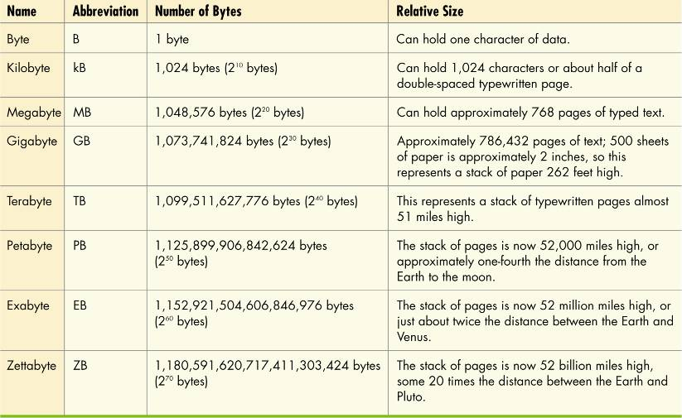
How Much Is a Byte?
Notes:
7
Not only are bits and bytes used as the language that tells the computer what to do, they are also what the computer uses to represent the data and information it inputs and outputs.
Kilobytes, megabytes, and gigabytes are therefore simply amounts of bytes.

Slide 10
Computer Software
Software: Programs that enable hardware to perform different tasks
  Application software
  System software
Notes:
8
Software is the set of computer programs that enables the hardware to perform different tasks.
There are two broad categories of software: application software and system software.
Application software is the set of programs you use on a computer to help you carry out tasks. If you’ve ever typed a document, created a spreadsheet, or edited a digital photo, for example, you’ve used a form of application software.
System software is the set of programs that enables your computer’s hardware devices and application software to work together. The most common type of system software is the operating system (OS). It manages the computer system’s hardware—such as the monitor and the printer. The operating system also provides a means by which users can interact with the computer.

Slide 11
Computer Software
Software: Programs that enable hardware to perform different tasks
  Application software
  System software
Notes:
8
Software is the set of computer programs that enables the hardware to perform different tasks.
There are two broad categories of software: application software and system software.
Application software is the set of programs you use on a computer to help you carry out tasks. If you’ve ever typed a document, created a spreadsheet, or edited a digital photo, for example, you’ve used a form of application software.
System software is the set of programs that enables your computer’s hardware devices and application software to work together. The most common type of system software is the operating system (OS). It manages the computer system’s hardware—such as the monitor and the printer. The operating system also provides a means by which users can interact with the computer.

Slide 12
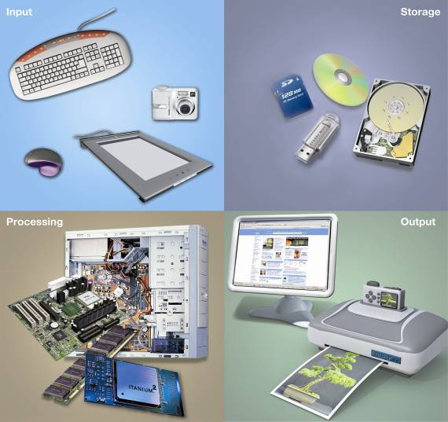
Computer Hardware
Notes:
11
Hardware components consist of the system unit and peripheral devices, such as monitors and printers that are connected to the computer.
Other hardware devices, such as routers, help a computer communicate with other computers to facilitate sharing documents and other resources.
Together, the system unit and peripheral devices perform four main functions: they enable the computer to input data, process that data, and output and store the data and information.

Slide 13
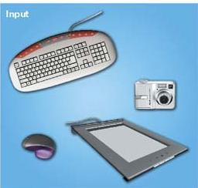
Input Devices
Devices used to enter information or instructions into the computer
  Keyboard
  Mouse/
  pointing device
  Stylus
  Scanner
  Digital camera
  Microphone
Notes:
12
An input device enables you to enter data (text, images, and sounds) and instructions (user responses and commands) into the computer.
The most common input devices are the keyboard and the mouse.
You use keyboards to enter typed data and commands, whereas you use the mouse to enter user responses and commands by clicking on an icon.
There are other input devices as well: microphones input sounds; scanners and digital cameras input nondigital text and digital images.
Styluses (devices that look like skinny pens but have no ink) and electronic pens are also becoming quite popular and are often used in conjunction with graphics tablets that can translate a user’s handwriting into digital input.

Slide 14
Output Devices
Send processed data out of the computer
  Monitors
  Printers
Output devices make:
  Soft copies (video, sounds, control signals)
  Hard copies (print)
Notes:
23
Output devices enable you to send processed data out of your computer. This can take the form of text, pictures (graphics), sounds (audio), and video.
One common output device is a monitor, which displays text, graphics, and video as soft copies (copies you can see only on-screen).
Another common output device is a printer, which creates tangible or hard copies of text and graphics.
Speakers are output devices for sound.

Slide 15
Power Controls
Power-on button: Turns on system, should not be used to turn it off
Other options:
  Sleep mode
  Hibernation
  Warm boot
Notes:
35
Your system has a power-on button on the front panel. Although you use this button to turn on your system, you don’t want to use it to turn off your system. You turn off the power by clicking on a shutdown icon on the desktop.
When your computer enters Sleep mode, all the documents, applications, and data you were using are stored in RAM, from which they are quickly accessible upon restarting your computer.
Hibernation is another power-saving mode that stores your data in memory and saves it to your computer's hard disk.
If you’re using Windows Vista, you can restart the computer when you click the right arrow button next to the lock button on the Start menu. This is called a warm boot. You might need to perform a warm boot if the operating system or other software application stops responding or if you have installed new programs.

Slide 16
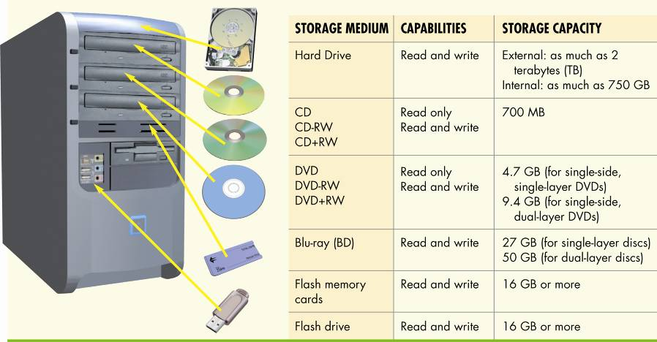
Storage Media Capabilities
Notes:
39
Here you see the storage capacities of the various portable storage media used in your computer’s drive bays. As you learned, storage capacity is measured in bytes.

Slide 17
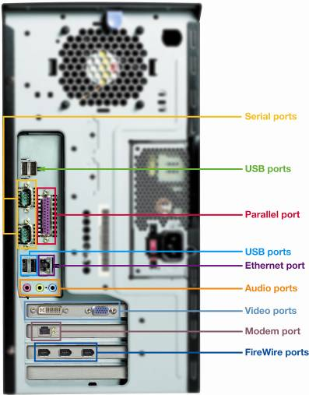
On the Back
Ports for peripherals
Types of ports:
  Serial and parallel
  Audio and video
  USB
  FireWire
  Connectivity
    Ethernet
    Modem
Notes:
38
Ports are the places on the system unit where peripheral devices attach to the computer so that data can be exchanged between them and the operating system.
Some ports are on the front of the system unit.
The ports on the back of the computer are mostly designed for long-term connections.

Slide 18
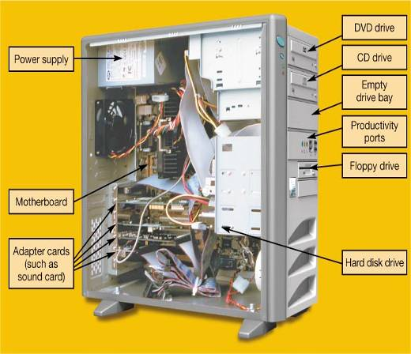
Inside the System Unit
Essential electronic components used to process data
Types of components:
  Power supply
  Hard disk drive
  Motherboard
  CPU
  Expansion cards
Notes:
41
The system unit contains the essential components of a computer. Inside are the power supply, motherboard, RAM, storage drives, expansion cards, and central processing unit. Today’s personal computer follows the same design concept as IBM’s first PC in 1981 did. All the components have evolved, but the foundation and concepts are the same.

Slide 19
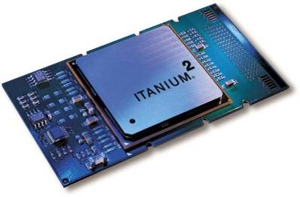
Central Processing Unit (CPU)
Referred to as the “brains” of the computer
Controls all functions of the computer
Processes all commands and instructions
Can perform billions of tasks per second
Notes:
43
The central processing unit (CPU, or processor) is the largest and most important chip in the computer.
It is sometimes referred to as the “brains” of the computer because it controls all the functions performed by the computer’s other components and processes all the commands issued to it by software instructions.
Modern CPUs can perform three billion tasks a second without error, making them extremely powerful components.

Slide 20
Memory Module
Random access memory (RAM)
Stores instructions and data
Temporary (volatile) storage
Operates in nanoseconds
Notes:
44
Random access memory (RAM) is a series of small cards plugged into slots on the motherboard. The CPU can request any data in RAM. It is then located, opened, and delivered to the CPU for processing in a few billionths of a second.
Because all the contents of RAM are erased when you turn off the computer, RAM is the temporary or volatile storage location for the computer.
To save data more permanently, you need to save it to the hard drive or to another permanent storage device such as a floppy disk, CD, or flash drive.

Slide 21
Expansion Cards
Add functions
Provide new connections for peripheral devices
Common types:
  Sound
  Modem
  Video (VGA)
  Network (NIC)
Notes:
44
The various circuit boards connected to the motherboard have specific functions that augment the computer’s basic functions.
Some provide connections to other devices; these are usually referred to as expansion cards. Typical expansion cards found in the system unit are the sound card and the video card.
Other expansion cards provide a means for network and Internet connections, such as the network interface card (NIC), which enables your computer to connect with other computers.

Slide 22
Specialty Computers
Mainframes
Supercomputers
Embedded computers
Personal Computers
Workstations
Personal Information Managers
Notes:
There are other types of computers besides desktop and notebook computers. Mainframes, although large and expensive, can support hundreds of users simultaneously and are designed to run many programs at once. Supercomputers can perform complex calculations rapidly and are designed to run a few programs quickly. Embedded computers are computer chips that are inside other devices such as your car and typically do not receive direct input from the user.

Slide 23
Chapter 2 Summary Questions
What exactly is a computer, and what are its four main functions?
Notes:
47
What exactly is a computer, and what are its four main functions?

Slide 24
Chapter 2 Summary Questions
What is the difference between data and information?
Notes:
48
What is the difference between data and information?

Slide 25
Chapter 2 Summary Questions
What are bits and bytes, and how are they measured?
Notes:
49
What are bits and bytes, and how are they measured?

Slide 26
Chapter 2 Summary Questions
What devices do you use to get data into the computer?
Notes:
50
What devices do you use to get data into the computer?

Slide 27
Chapter 2 Summary Questions
What devices do you use to get information out of the computer?
Notes:
51
What devices do you use to get information out of the computer?

Slide 28
Technology in Action
Chapter 3
Using the Internet:
Making the Most of the Web’s Resources
Notes:
Chapter 3 presents an introduction to the history of the Internet, its structure, and how it is used.

Slide 29
Origin of the Internet
Internet is a network of networks connecting billions of computers globally
Developed while U.S. was in midst of Cold War with Soviet Union
Created to respond to two concerns:
  Establishing a secure form of military communications
  Creating a means by which all computers could communicate
Notes:
The Internet is a network of networks that connects billions of computer users globally.
The concept of the Internet was developed while the United States was in the midst of the Cold War with the Soviet Union. At that time, the U.S. armed forces needed a computer system that would operate efficiently and that was located in various parts of the country so that it could not be disrupted easily in the event of an attack.
The Internet was created to respond to these two concerns: establishing a secure form of military communications and creating a means by which all computers could communicate.

Slide 30
Origin of the Internet (cont.)
Evolved from Advanced Research Projects Agency Network (ARPANET)
  Vinton Cerf
  Robert Kahn
First communication occurred in 1969
World Wide Web is subset of the Internet
  Common protocols enable computers to talk to each other
  Special links enable navigation
Notes:
The modern Internet evolved from an early U.S. government-funded “internetworking” project called the Advanced Research Projects Agency Network (ARPANET). ARPANET began as a four-node network involving UCLA, Stanford Research Institute, the University of California at Santa Barbara, and the University of Utah in Salt Lake City. The first real communication occurred in late 1969 between the computer at Stanford and the computer at UCLA. Although the system crashed after the third letter was transmitted, it was the beginning of a revolution.
Many people participated in the creation of the ARPANET, but two men who worked on the project, Vinton Cerf and Robert Kahn, are generally acknowledged as the “fathers” of the Internet. They earned this honor because in the 1970s they were primarily responsible for developing the communications protocols (standards) that are still in use on the Internet today.
Because the World Wide Web (WWW or the Web) is what we use the most, we sometimes think of the Internet and the Web as being interchangeable. However, the Web is a subset of the Internet, dedicated to broadcasting HTML pages and the means by which we access information over the Internet. What distinguishes the Web from the rest of the Internet is its use of:
Common communication protocols that enable different computers to talk to each other and display information in compatible formats
Special links that enable users to navigate from one place to another on the Web

Slide 31
Wikis
A Wiki is a type of Web site that allows users to change content
Wikipedia uses wiki technology so content can be updated continually
Google Docs has wiki-like features
Wiki technology is incorporated in course management systems such as Blackboard
Notes:
The viewer of a traditional Web site cannot change the content. In contrast, a wiki is a type of Web site that allows users to add, remove, or edit the content. Wikis add the extra benefit of tracking revisions so that past versions can be easily accessed at any time by any eligible reader
Wikis provide an excellent source for collaborative writing, both in and out of the classroom. The popular collaborative online encyclopedia Wikipedia (www.wikipedia.org) uses wiki technology so that the content can be updated continually. Some Web-based document products, such as Google Docs (docs.google.com), have wiki-like features to promote online collaboration.
Wiki technology is currently incorporated in course management systems such as Blackboard, to encourage collaborative learning in online courses.

Slide 32
Podcasts
A podcast is a clip of audio or video content broadcast over the Internet using compressed files
  Files that come to you through syndication
  Podcasts are available in a wide variety of topics and content
Notes:
A podcast is a clip of audio or video content that is broadcast over the Internet using compressed audio and video files such as MP3s and MP4s. The word podcast is a combination of broadcasting and iPod—not because you have to use an iPod but because iPods are the most popular form of portable media player (PMP) and because people download audio files to listen to on their iPods. However, you don’t have to listen to podcasts on a portable media player. You can listen to podcasts on your computer or even on a smartphone as long as the device can play the content
Podcasts are files that come to you through syndication so you do not have to search for the current episode once you have subscribed to the series. Perhaps you are used to getting your news from a certain Web site, but the only way you can determine that new content has been added is to go to the site and look for the newly added information. In contrast, if you subscribe to podcasts, when the content changes, it is brought to you.
Podcasts are available in a wide variety of topics and content.

Slide 33
E-Commerce Safeguards
Businesses must have some form of security certification to give customers a level of comfort
  Secure logins
  URL starts with https://
  Padlock icon in toolbar
  Green address bar
Notes:
Because online shopping eliminates a salesclerk or other human intermediary from the transaction, it can actually be safer than traditional retail shopping. Still, because users are told to be wary of online transactions and because the integrity of online transactions is the backbone of e-commerce, businesses must have some form of security certification to give their customers a level of comfort.
Some sites have created secure logins that you can change to before signing in, which is safer than sending your login credentials unsecured
Be sure to check that the beginning of the URL changes from “http://” to “https://”—with the “s” standing for secure socket layer.
Another indication that a Web site is secure is the appearance of a small icon of a closed padlock in the toolbar (in both Microsoft Internet Explorer and Mozilla Firefox).
The last visual clue to help identify a safe site is a green-colored address bar.

Slide 34
Popular Web Browsers
Microsoft Internet Explorer (IE)
  Included with Windows
Mozilla Firefox
  Open source browser gaining popularity
Safari
  Developed by Apple for Mac OS
Google Chrome
  Newest browser offers thumbnail access
Notes:
Microsoft Internet Explorer (IE) is included in the Windows operating system. It has been the most widely used browser since 1999, and still enjoys predominant market share, although its popularity has slipped over the years.
Firefox is a popular open source browser from Mozilla (www.mozilla.org). Firefox’s popularity continues to increase, capturing approximately 28 percent of the U.S. browser market.
Safari is a browser developed by Apple (www.apple.com/safari). Although it was created as the default browser for Macintosh computers and is included with the Mac OS, a Windows-based version is also available. Safari has quickly gained public acceptance.
Google Chrome is the newest browser on the market, distributed by Google (www.google.com/chrome) (see Figure 3.18) and has enjoyed growing market share since its inception. The unique features offered by Chrome include thumbnail access to your most recently visited sites from Chrome’s main page and shortcuts to Google applications.

Slide 35
Getting Around the Web:
URLs, Hyperlinks, and Other Tools
Every Web site has a unique address
Uniform Resource Locator (URL)
Type URL in browser to connect to home page
Move around site using hyperlinks
Notes:
You gain initial access to a particular Web site by typing its unique address, or Uniform Resource Locator (URL, pronounced “you-are-ell”), in your browser. By typing this URL, you connect to the home page, or main page, of the Web site.
Once you are at the home page, you can move all around the site by clicking specially formatted pieces of text called hyperlinks.

Slide 36
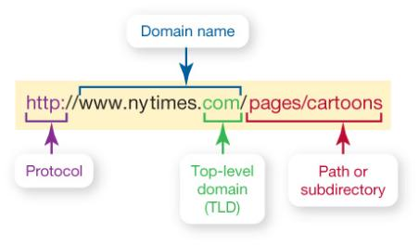
Parts of URL
URL
Notes:
As noted earlier, a URL is a Web site’s address. A Web site is composed of many different Web pages, each of which is a separate document with its own unique URL.
Like a regular street address, a URL is composed of several parts that help identify the Web document it stands for.
The first part of the URL indicates the protocol (set of rules) used to retrieve the specified document. The protocol is generally followed by a colon, two forward slashes, www (indicating World Wide Web), and the domain name. (Sometimes the domain name is also thought to include the www.) The domain name is also referred to as the host name.
Individual pages within a Web site are further identified after the domain name, following another forward slash. These are referred to as the path. It should be noted that most current browsers no longer require you to enter the protocol and the www. Some, like Firefox, don’t even require the domain if it’s a .com. But even though these parts of the URL are not physically entered, they are still part of each Web site’s URL.

Slide 37
Top-Level Domains
Domain Name | Who Can Use the Domain Name
.biz | Businesses
.com | Originally for commercial sites but can be used by anyone now
.edu | Degree-granting institutions
.gov | Local, state, and United States government
.info | Information service providers
.mil | United States military
.name | Individuals
.net | Originally for networking organizations, no longer restricted
.org | Organizations (often nonprofits)
Notes:
The suffix in the domain name after the dot (such as .com or .edu) is called the top-level domain. This suffix indicates the kind of organization to which the host belongs.
Each country has its own top-level domain. These are two-letter designations such as .za for South Africa and .us for the United States.

Slide 38
Search Engines
Search engines have three components:
  Spider constantly collects data on the Web
  Search engine organizes the data into large database
  Search engine software searches indexed data pulling out relevant information
Resulting list appears in your Web browser as list of hits
Notes:
Search engines have three components. The first component is a program called a spider. The spider constantly collects data on the Web, following links in Web sites and reading Web pages. Spiders get their name because they crawl over the Web using multiple “legs” to visit many sites simultaneously.
As the spider collects data, the second component of the search engine, an indexer program, organizes the data into a large database.
When you use a search engine, you interact with the third component: the search engine software. This software searches the indexed data, pulling out relevant information according to your search. The resulting list appears in your Web browser as a list of hits (sites that match your search).

Slide 39
Chapter 3 Summary Questions
What is the origin of the Internet?
Notes:
1. What is the origin of the Internet?
The Internet is the largest computer network in the world, connecting millions of computers. Government and military officials developed the early Internet as a reliable way to communicate in the event of war. Eventually, scientists and educators used the Internet to exchange research. Today, we use the Internet and the Web (which is a part of the Internet) to shop, research, communicate, and entertain ourselves.

Slide 40
Chapter 3 Summary Questions
7. What is a Web browser, and what is a URL and its parts?
Notes:
7. What is a Web browser, and what is a URL and its parts?
Once you’re connected to the Internet, in order to locate, navigate to, and view Web pages, you need to install special software called a Web browser on your system. The most common Web browsers are Internet Explorer, Firefox, Google Chrome, and Safari. You gain access to a Web site by typing in its address, called a Uniform Resource Locator (URL). A URL is composed of several parts, including the protocol, the domain, the top-level domain, and paths (or subdirectories).

Slide 41
Technology in Action
Chapter 4
Application Software:
Programs That Let You Work and Play
Notes:
This chapter discusses the kinds of software you can use to perform a variety of tasks, from simple word processing to digital image editing. We’ll also discuss how you can buy software, what the different versions of software mean, how you can legally get free software from the Web, and how you install and uninstall software safely on your system.

Slide 42
Web Based Applications
Software as a Service (SaaS)
Application is hosted online
Made available over the Internet
Microsoft Office Web Apps have fewer tabs than installed version
Microsoft Web Apps have fewer options
Notes:
Most application software you acquire must be installed on your computer before use.
There is a relatively new trend toward a distribution model of on-demand software deployment, referred to as Software as a Service (SaaS). With the SaaS delivery model, the application is hosted online by the vendor and made available to the customer over the Internet. These applications are also referred to as Web-based applications. Web-based applications are run from software stored completely on a Web server.
Along with its release of Office 2010, Microsoft made available Microsoft Office Web Apps. Office Web Apps are online versions of Word, Excel, PowerPoint, and OneNote, but with fewer tabs than the installed versions.

Slide 43
Productivity Software for
Home and Office
Programs that enable you to perform tasks required at home, school, and business
  Word processing
  Spreadsheet
  Presentation
  Database
  Personal information manager
Notes:
Productivity software includes programs that enable you to perform various tasks required at home, school, and business. This category includes word processing, spreadsheet, presentation, database, and personal information manager (PIM) programs.

Slide 44
Software Suites
Group of software programs bundled as a package
Cheaper than buying individual programs
Compatibility between programs
Share common features, toolbars, menus
Microsoft Office is standard for proprietary software suites
Notes:
A software suite is a group of software programs that have been bundled as a package. You can buy software suites for many different categories of software, including productivity, graphics, and virus protection.
Microsoft Office 2010 is the standard for proprietary software suites, and is available for both Windows-based and Apple computers. Apple offers productivity software for Macs in its iWork suite.
It is cheaper to buy a software suite than to buy each program individually. Another benefit of software suites is the compatibility between programs. Because the programs bundled in a software suite come from the same company, they work well together (that is, they provide for better integration) and share common features, toolbars, and menus.

Slide 45
Chapter 4 Summary Questions
What’s the difference between application software and system software?
Notes:
1. What’s the difference between application software and system software?
Application software is the software you use to do everyday tasks at home, school, and work. Application software includes productivity software, such as word processing and finance programs; media software, such as applications used for image and video editing; home and entertainment software, such as games or educational programs; and business software for small and large businesses. System software is the software that helps run the computer and coordinates instructions between application software and the computer’s hardware devices. System software includes the operating system and utility programs.

Slide 46
Chapter 4 Summary Questions
What are Web-based applications, and how do they differ from traditional modes of software distribution?
Notes:
2. What are Web-based applications, and how do they differ from traditional modes of software distribution?
Web-based applications are those that are hosted online by the vendor and made available to the customer over the Internet. This distribution model of on-demand software deployment is also referred to as Software as a Service (SaaS). Unlike traditional software that needs to be installed on individual machines or network servers, Web-based applications are accessed via an Internet connection to the host server. The appeal of Web-based applications is that they can be accessed from any machine that has an Internet connection and they can facilitate collaboration because many people can access the same file and work together in real time.

Slide 47
Chapter 4 Summary Questions
What kinds of applications are included in productivity software?
Notes:
3. What kinds of applications are included in productivity software?
Productivity software programs include word processing, spreadsheet, presentation, note taking, personal information manager (PIM), and database programs. You use word processing software to create and edit written documents. Spreadsheet software enables you to do calculations and numerical and what-if analyses easily. Presentation software enables you to create slide presentations. Note taking software provides a convenient means to take extensive notes or to just jot down a few thoughts. You can easily organize and search your notes. PIM software helps keep you organized by putting a calendar, address book, notepad, and to-do lists within your computer. Database programs are powerful applications that allow you to store and organize data. Individuals can also use software to help with business-like tasks such as preparing taxes and managing personal finances.

Slide 48
Technology in Action
Chapter 5
Using System Software:
The Operating System, Utility Programs,
and File Management
Notes:
This chapter discusses system software and how vital it is to your computer. We examine the operating system (OS) by looking at the different operating systems on the market as well as the tasks the OS manages. We’ll also discuss how you can use the OS to keep your files and folders organized so that you can use your computer more efficiently. Finally, we’ll look at the many utility programs included as system software on your computer.

Slide 49
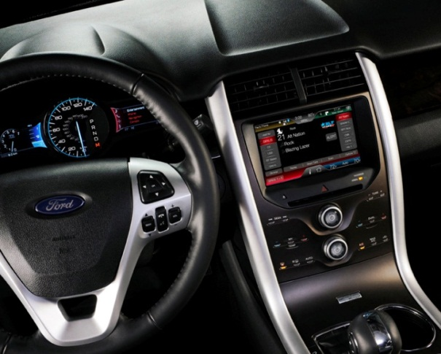
Real-Time Operating Systems
Used for machinery that performs a repetitive series of specific tasks in an exact amount of time
Requires minimal user interaction
  Car engines
  Medical devices
  Common appliances
  Robotic cameras
Notes:
Machinery that is required to perform a repetitive series of specific tasks in an exact amount of time requires a real-time operating system (RTOS). Real-time operating systems, also referred to as embedded systems, require minimal user interaction. This type of operating system is a program with a specific purpose, and it must guarantee certain response times for particular computing tasks; otherwise, the machine is useless.
Devices that must perform regimented tasks or record precise results—such as measurement instruments found in the scientific, defense, and aerospace industries—require real-time operating systems.
You also encounter real-time operating systems in everyday life. They are in devices such as fuel-injection systems in car engines, automobile “infotainment” systems, inkjet printers, VoIP phones, and some medical devices, as well as some common appliances. Real-time operating systems are also found in many types of robotic equipment. Television stations use robotic cameras with real-time operating systems that glide across a suspended cable system to record sports events from many angles (see Figure 5.2).

Slide 50
Operating Systems for Networks, Servers, and Mainframes
Multiuser operating system enables more than one user to access the computer at one time
Networks require a multiuser operating system
Manage all user requests, ensuring they do not interfere with each other
Examples include Windows Server, Linux, and UNIX
Notes:
A multiuser operating system (also known as a network operating system) enables more than one user to access the computer system at one time by efficiently handling and prioritizing requests from multiple users. Networks (groups of computers connected to each other for the purposes of communicating and sharing resources) require a multiuser operating system because many users simultaneously access the server, which is the computer on a network that manages network resources such as printers.
The latest versions of Microsoft Windows and Mac OS X can be considered network operating systems; they enable users to set up basic networks for use in homes and small businesses. In larger networks, a more robust network operating system is installed on the server and manages all user requests, ensuring they do not interfere with each other.
Examples of network operating systems include Windows Server, Linux, and UNIX.

Slide 51
What the Operating System Does
Coordinates and directs the flow of data and information
  Provides a user interface
  Manages the processor, or CPU
  Manages memory and storage
  Manages hardware and peripheral devices
  Provides means for software applications to work with the CPU
Notes:
The operating system coordinates and directs the flow of data and information through the computer system. In doing so, the OS performs several specific functions:
It provides a way for the user to interact with the computer.
It manages the processor, or CPU.
It manages the memory and storage.
It manages the computer system’s hardware and peripheral devices.
It provides a consistent means for software applications to work with the CPU.

Slide 52
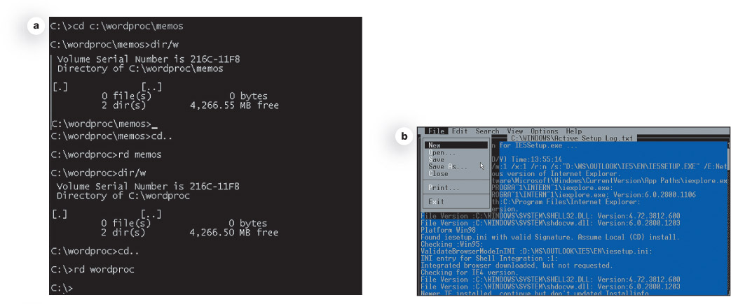
The User Interface
Enables user to interact with the computer
Types of interfaces
  Command-driven interface
  Menu-driven interface
  Graphical user interface (GUI)
Notes:
The operating system provides a user interface that enables you to interact with the computer.
The first personal computers had a DOS operating system with a command-driven interface. A command-driven interface is one in which you enter commands to communicate with the computer system. The DOS commands were not always easy to understand; as a result, the interface proved to be too complicated for the average user. Therefore, PCs were used primarily in business and by professional computer operators.
A menu-driven interface is one in which you choose commands from menus displayed on the screen. Menu-driven interfaces eliminated the need for users to know every command because they could select most of the commonly used commands from a menu. However, they were still not easy enough for most people.
Current personal computer operating systems such as Microsoft Windows and Mac OS use a graphical user interface, or GUI (pronounced “gooey”). Unlike command- and menu-driven interfaces, GUIs display graphics and use the point-and-click technology of the mouse and cursor, making them much more user-friendly.

Slide 53
Processor Management
CPU usually is asked to perform several tasks at once
OS arranges for execution of all activities
Assigns a slice of time to each activity
Switches among processes millions of times a second
Appears that everything is happening seamlessly
Notes:
When you use your computer, you are usually asking the CPU to perform several tasks at once. For example, you might be printing a Word document, chatting with your friends on Facebook, watching a movie using the Blu-ray drive, and working on an Excel spreadsheet—all at the same time, or at least what appears to be at the same time.
Although the processor is the powerful brain of the computer, processing all of its instructions and performing all of its calculations, it needs the OS to arrange for the execution of all these activities in a systematic way, creating the appearance that everything is happening simultaneously.
To do so, the operating system assigns a slice of its time to each activity that requires the processor’s attention. The OS must then switch among different processes millions of times a second to make it appear that everything is happening seamlessly. Otherwise, you wouldn’t be able to watch a movie and print at the same time without experiencing delays in the process.

Slide 54
Memory & Storage Management
OS uses RAM as temporary storage area for instructions and data
Processor accesses these instructions and data from RAM when it needs them
OS is responsible for coordinating space allocation in RAM
Clears item from RAM when processor no longer needs them
Notes:
As the operating system coordinates the activities of the processor, it uses RAM as a temporary storage area for instructions and data the processor needs.
The processor then accesses these instructions and data from RAM when it is ready to process them.
The OS is therefore responsible for coordinating the space allocations in RAM to ensure that there is enough space for all of the pending instructions and data. It then clears the items from RAM when the processor no longer needs them.

Slide 55
Common File Name Extensions
Extension | Type of Document | Application
.doc | Word processing document | Microsoft Word 2003
.docx | Word processing document | Microsoft Word 2007 and 2010
.xlsx | Spreadsheet | Microsoft Excel 2007 and 2010
.accdb | Database | Microsoft Access 2007 and 2010
.pptx | PowerPoint presentation | Microsoft PowerPoint 2007 and 2010
.pdf | Portable Document Format | Adobe Acrobat or Adobe Reader
.rtf | Text (Rich Text Format) | Program that can read text documents
.txt | Text | Program that can read text documents
.htm /.html | Hyper Text Markup Language | Any program that can read HTML
.jpg | JPEG image | Programs capable of displaying images
.zip | Compressed file | WinZip

Slide 56
Working with Files
File-management actions
  Open
  Copy
  Move
  Rename
  Delete
    Recycle Bin (Windows)
    Trash (Mac)
Notes:
Once you’ve located your file with Windows Explorer, you can perform many other file-management actions such as opening, copying, moving, renaming, and deleting files. You open a file by double-clicking the file from its storage location. Based on the file extension, the operating system then determines which application needs to be started to open the requested file and opens the file within the correct application automatically.
You can copy a file to another location using the Copy command. When you copy a file, a duplicate file is created and the original file remains in its initial location.
To move a file from one location to another, use the Move command. When you move a file, the original file is deleted from its former location and saved in the new location.
The Recycle Bin is a folder on the desktop where files deleted from the hard drive reside until you permanently purge them from your system. Unfortunately, files deleted from other drives (such as a DVD drive, flash drive, external hard drive, or network drive) do not go to the Recycle Bin but are deleted from the system immediately. (Mac systems have something similar to the Recycle Bin, called Trash, which is represented by a wastebasket icon. To delete files on a Mac, drag the files to Trash on the Dock.)
Files placed in the Recycle Bin or Trash remain in the system until they are permanently deleted. To delete files from the Recycle Bin permanently, select Empty the Recycle Bin after right-clicking the desktop icon. On Macs, select Empty Trash from the Finder menu in OS X.

Slide 57
Chapter 5 Summary Questions
What software is included in system software?
Notes:
1. What software is included in system software?
System software is the set of software programs that helps run the computer and coordinates instructions between application software and hardware devices. It consists of the operating system (OS) and utility programs. The OS controls how your computer system functions. Utility programs are programs that perform general housekeeping tasks for the computer, such as system maintenance and file compression.

Slide 58
Chapter 5 Summary Questions
What are the different kinds of operating systems?
Notes:
2. What are the different kinds of operating systems?
There are many different kinds of operating systems. Real-time operating systems (RTOSs) require no user intervention. They are designed for systems with a specific purpose and response time (such as robotic machinery). Smartphones have their own specific operating systems, the latest of which allow the user to multitask. Current operating systems for desktops, notebooks, and netbooks have multitasking capabilities, as well as networking capabilities.

Slide 59
Chapter 5 Summary Questions
How does the operating system provide a means for users to interact with the computer?
Notes:
4. How does the operating system provide a means for users to interact with the computer?
The operating system provides a user interface that enables users to interact with the computer. Most OSs today use a graphical user interface (GUI). Unlike the command- and menu-driven interfaces used earlier, GUIs display graphics and use the point-and-click technology of the mouse and cursor, making the OS more user-friendly. Common features of GUIs include windows, menus, and icons.

Slide 60
Technology in Action
Chapter 6
Understanding and Assessing Hardware: Evaluating Your System
Notes:
In this chapter we’ll begin by helping you design the optimal system for your needs. Then we’ll examine all the subsystems of a computer and learn how to evaluate their performance and what upgrades are easily available, to help you end up with a system you just love.

Slide 61
Hyperthreading and
Multi-Core Processing
Hyperthreading allows a new set of instructions to start before previous set has finished
Multiple cores used on one CPU chip enable execution of two sets of instructions at the same time
Possible to design CPU to have multiple cores and hyperthreading
Notes:
CPUs began to execute more than one instruction at a time quite a while ago, when hyperthreading was introduced. Hyperthreading provides quicker processing of information by enabling a new set of instructions to start executing before the previous set has finished.
The most recent design innovation for PC processors, an improvement upon hyperthreading, is the use of multiple cores on one CPU chip. With multiple core technology, two or more processors reside on the same chip, enabling the execution of two sets of instructions at the same time.
With multiple cores, each program has the full attention of its own processing core. This results in faster processing and smoother multitasking.
It is possible to design a CPU to have multiple cores and hyperthreading. The Intel i7-990X has six cores, each one using hyperthreading, so it simulates having twelve processors!

Slide 62
Front Side Bus
Connects the processor (CPU) to system memory
Throughput of FSB depends on how much data it transfers per cycle (bytes) and its clock frequency (Hz)
The faster the FSB, the faster you get data to the processor
Notes:
The front side bus (FSB) connects the processor (CPU) in your computer to the system memory. Think of the front side bus as the highway on which data travels between the CPU and RAM. The total number of cars that whiz by in one minute would depend on the number of lanes of highway and the speed of the cars.
Similarly, the throughput of the FSB depends on how much data it transfers per cycle (bytes) and its clock frequency (Hz). The faster the FSB is, the faster you can get data to your processor. The faster you get data to the processor, the faster your processor can work on it.

Slide 63
Adding RAM
Motherboard has specific number of slots for memory cards
Each slot has limit on amount of RAM it can hold
Operating system imposes own RAM limit
  Windows 7 (32 bit) maximum is 4 GB
  Windows 7 (64 bit) maximum is 192 GB
Notes:
Every computer has a maximum limit on the amount of RAM it can support. A motherboard is designed with a specific number of slots into which the memory cards fit, and each slot has a limit on the amount of RAM it can hold. To determine your specific system limits, check the system manufacturer’s Web site.
In addition, the operating system running on your machine imposes its own RAM limit. For example, the maximum amount of RAM for the 32-bit version of Windows 7 is 4 GB, while the maximum memory you can install using the 64-bit version of Windows 7 Ultimate is 192 GB.

Slide 64
Technology in Action
Chapter 7
Networking:
Connecting Computing Devices
Notes:
This chapter discusses connecting computing devices via a computer network.

Slide 65
Network Architectures
Network architecture refers to the design of a network
Classified in two ways:
  Manner in which they are controlled
    Peer to peer
    Client server
  Distance between their nodes
    Bus
    Ring
    Star topology
Notes:
The term network architecture refers to the design of a network. Network architectures are classified according to the way in which they are controlled and the distance between their nodes.

Slide 66
Networks Based on Distance
Local area network (LAN) is a network where nodes are located within small geographic area
Wide area network (WAN) is made up of LANs connected over long distances
Notes:
The distance between nodes on a network is another way to describe a network.
A local area network (LAN) is a network in which the nodes are located within a small geographic area. Examples include a network in a computer lab at school or at a fast-food restaurant.
A home area network (HAN) is a network located in a home. HANs are used to connect all of a home’s digital devices, such as computers, peripherals, phones, gaming devices, digital video recorders (DVRs), and televisions.
A wide area network (WAN) is made up of LANs connected over long distances. Say a school has two campuses (east and west) located in different towns. Connecting the LAN at the east campus to the LAN at the west campus by telecommunications lines would allow the users on the two LANs to communicate. The two LANs would be described as a single WAN.
Technically, wireless networks like the one deployed in Minneapolis, which provides Internet access to city residents and visitors, are WANs. However, when a network is designed to provide access to a specific geographic area, such as an entire city, the network is usually called a metropolitan area network (MAN). Many cities in the United States are now deploying MANs to provide Internet access to residents and provide convenience for tourists.

Slide 67
Network Navigation Devices
Hub
Router
  Transfers packets between two or more networks
Switch
  Receives data packets and sends them to intended nodes on same network
Bridge – Connects dissimilar networks
Notes:
Network navigation devices facilitate and control the flow of data through a network. Data is sent over transmission media in bundles called packets.
The two most common navigation devices are routers and switches. A router transfers packets of data between two or more networks.
A switch is a “traffic cop” on a network. Switches receive data packets and send them to their intended nodes on the same network (not between different networks). All routers sold for home use have switches integrated into them.

Slide 68
Broadband Connections
Broadband is often referred to as high-speed Internet with data transmission rate of 256 Kbps or greater
  Digital subscriber line (DSL) uses same types of wiring as standard phone lines
  Cable uses television’s cable service provider
  Fiber-optic service uses plastic or glass cables
  Satellite broadband used in rural and mountain areas
Notes:
Broadband, often referred to as “high-speed Internet,” refers to a type of connection that offers a faster means to connect to the Internet. Broadband usually has a data transmission rate of 256 Kbps (kilobits per second) or greater. This high rate of access is in contrast to dial-up Internet access, which has a maximum transmission speed of 56 Kbps.
The standard broadband technologies in most areas are digital subscriber line (DSL), which uses the same types of wiring used in standard phone lines to connect your computer to the Internet, and cable, which uses your television’s cable service provider to connect to the Internet.
Fiber-optic service, which uses plastic or glass cables to transfer data at the speed of light, has in the past few years become widely available as a broadband service to the home. Satellite broadband is mostly used in rural or mountain areas that cannot get DSL, cable, or fiber-optic service.

Slide 69
Home Network Cabling
Unshielded twisted-pair (UTP) cable
  Most popular cable for Ethernet networks
  Composed of four pairs of wires that are twisted around each other to reduce electrical interference
RJ-45 connectors have contacts for eight wires
Cat 6 cable best choice for home networks
Notes:
The most popular transmission media option for wired Ethernet networks is unshielded twisted-pair (UTP) cable that is composed of four pairs of wires that are twisted around each other to reduce electrical interference.
RJ-45 or Ethernet connectors resemble standard phone connectors but are slightly larger and have contacts for eight wires (four pairs).
Cat 6 cable is designed to achieve data transfer rates that support a gigabit Ethernet network, and is probably the best choice for home networking cable.

Slide 70
Chapter 7 Summary Questions
What is a network, and what are the advantages/disadvantages of setting up one?
Notes:
1. What is a network, and what are the advantages/disadvantages of setting up one?
A computer network is simply two or more computers that are connected using software and hardware so they can communicate. Advantages of networks include allowing users to (1) share an Internet connection, (2) share peripheral devices, and (3) share files. A disadvantage is that the network must be administered.

Slide 71
Chapter 7 Summary Questions
What is the difference between a client/server network and a peer-to-peer network?
Notes:
2. What is the difference between a client/server network and a peer-to-peer network?
In peer-to-peer networks, each node connected to the network can communicate directly with every other node instead of having a separate device exercise central control over the network. P2P networks are the most common type of network installed in homes. Most networks that have 10 or more nodes are client/server networks. A client/server network contains two types of computers: a client computer on which users perform specific tasks and a server computer that provides resources to the clients and central control for the network.

Slide 72
Chapter 7 Summary Questions
What are my options for connecting to the Internet?
Notes:
4. What are my options for connecting to the Internet?
Home users have many options for connecting to the Internet. A dial-up connection, in which you connect to the Internet using a standard phone line, was at one time the standard way to connect to the Internet. Today’s broadband connections are faster and have made dial-up a legacy connection technology. Broadband connections include cable, DSL, and fiber-optic cable. Satellite is a connection option for those who do not have access to faster broadband technologies. WiFi allows users to connect to the Internet wirelessly, but is not as fast as a wired connection.

Slide 73
Chapter 7 Summary Questions
Which type of network is most commonly found in the home?
Notes:
5. Which type of network is most commonly found in the home?
Ethernet networks are the most common networks used in home networking. Most Ethernet networks use a combination of wired and wireless connections, depending upon the data throughput required. Wired connections usually achieve higher throughput than wireless connections.

